Slide 1
IBM Cloud Overview

Slide 2
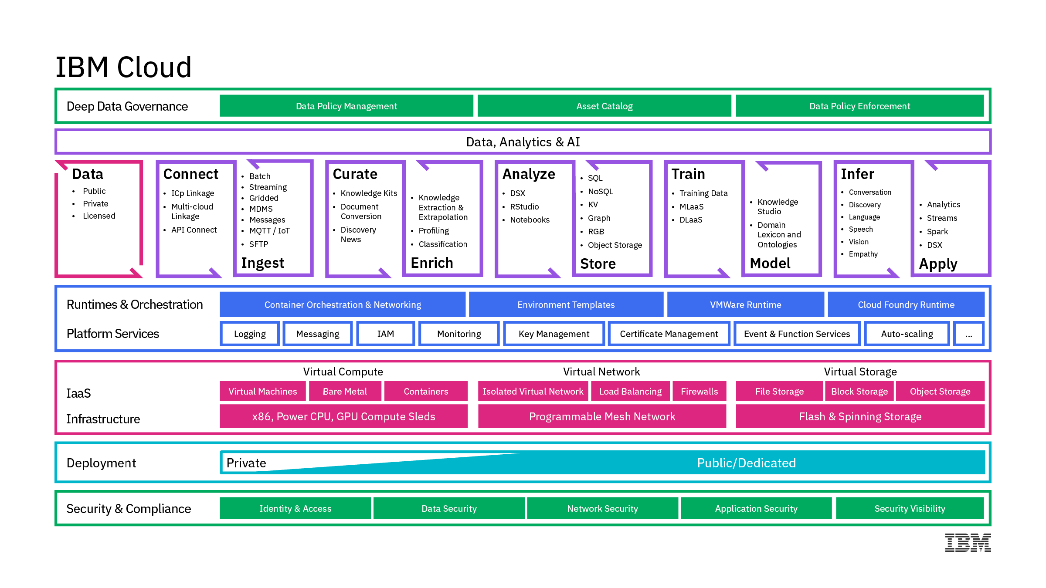
Architecture
2

Slide 3





IBM offers the complete spectrum of cloud deployment models to support clients wherever they are in their Cloud Journey
Choice with consistency
Hybrid integration
PUBLIC
DEDICATED
PRIVATE
DevOps productivity
Maximize on cloud agility and economics
Public cloud benefits, with dedicated infrastructure
Behind the firewall for the most demanding workloads
Powerful, accessible data and analytics
Cognitive solutions
Seamless Experience
Regardless of which combination you choose, you get a single, seamless experience.
3
Notes:
IBM offers the complete spectrum of cloud deployment models to meet your needs
Seamless experience, including…. see points on chart
*****
A successful multi-cloud adoption includes a seamless experience across all clouds, regardless if they are Public (hosted off-premises), Dedicated (hosted off-premises but in an environment dedicated to only a specific organization), or Private (customer managed within the firewall of an organization’s data center).
IBM’s strategy is to provide a seamless experience across all three environments, which includes:
Choice with consistency
Hybrid integration
DevOps productivity
Powerful, accessible data and analytics
Cognitive solutions
Regardless of which combination of cloud adoption an organization chooses, IBM delivers a seamless experience.

Slide 4











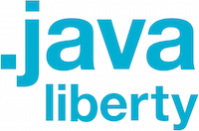
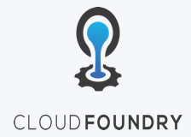
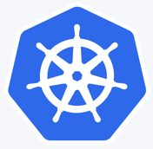


Hybrid Cloud is a key differentiator
IBM provides the strongest cloud integration
for unified cloud native developer experience
across Public & Private Clouds
IBM Cloud Public
IBM Cloud Private
AI/Machine Learning/Data Services
Bring IBM Middleware apps and license to IBM Cloud
Region Level Cloud APIs (HA/DR)
IBM Middleware, Data, Analytics
API Connect
& Mgmt
IBM Middleware, Data, Analytics (BYOL or aaS)
Connect
+
Web
Data
Mobile
Cognitive
Analytics
IoT
Security
Core Operational Services
Language Runtimes
Extend
Federated Catalog
Core Operational Services
Language Runtimes
API Cnnect
& Mgmt
Modernize
API Cnnect
& Mgmt
Kubernetes-based Container Platform
Kubernetes-based Container Platform
Migrate
Serverless Computing
VSI
SAP certified servers
Cloud Object Store
LBaaS
Dedicated Env
4
Notes:
I talked earlier about IBM Hybrid Cloud solution as a key differentiator in the Cloud Wars. This is a visual of that single architecture.
We have the strongest cloud integration for unified cloud native developer experience across Public & Private Clouds.
The IBM Cloud is optimized for cognitive workloads and provides clients with the ability to integrate public, private, and managed environments through a single architecture.
We have been working with Arvind’s team on the Hybrid Cloud Alignment motion to demonstrate this at Think.

Slide 5
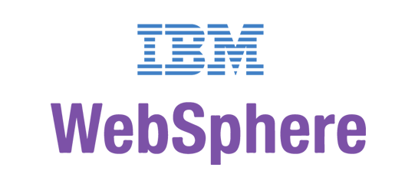
Solution Overview
IBM Middleware, Data, Analytics and Developer Services
Cloud enabled middleware, messaging, databases, analytics, and cognitive services
Core Operational Services Simplify Operations Management, Security, and Hybrid integration Provision infrastructure and apps across Multi-Cloud environments
Kubernetes-based Container Platform
Industry leading container orchestration platform
Cloud Foundry
For prescribed app dev & deployment
Terraform
For multi-cloud management
(Cloud Automation Manager)
Runs on existing IaaS:
System Z
IBM Spectrum
5
5

Slide 6
IBM Cloud Private How does our platform add value?

Slide 7
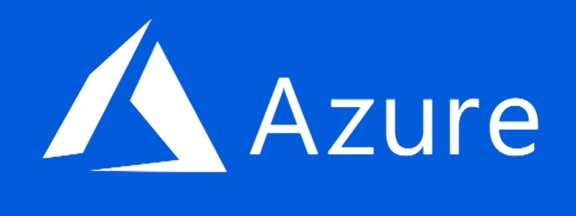

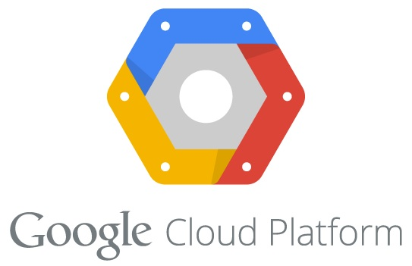

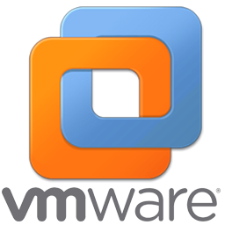

IBM Cloud Automation Manager on IBM Cloud Private
Containerized cloud native application
Installed into an IBM Cloud Private worker node with a Helm chart
Leverages IBM Cloud Private services for enterprise capabilities
Deployment & Process Orchestration
Service & Template
Library
3rd Party Integrations
Service
Composer
Flow Engine
Template Management
Instance Management
Template API
Workload
Terraform
Helm
Service
Public, Private & Hybrid Clouds
IaaS Management
IBM Cloud Private
Service catalog
Multi-cloud
Services
Infrastructure
Data & Analytics Services
Core Services
Kubernetes
Databases
Analytics
CAM
IAM
Logging
Audit
API & Data Connect
Encryption & Key Management
Monitoring
Usage
Metering
Event
Tenant Svcs

Slide 8

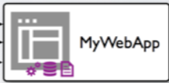
Most apps today aren’t in containers
… and customers need help to modernize these workloads
IBM Transformation Advisor enables insights into existing apps which is part of our universal platform for IBM middleware in containers

Slide 9
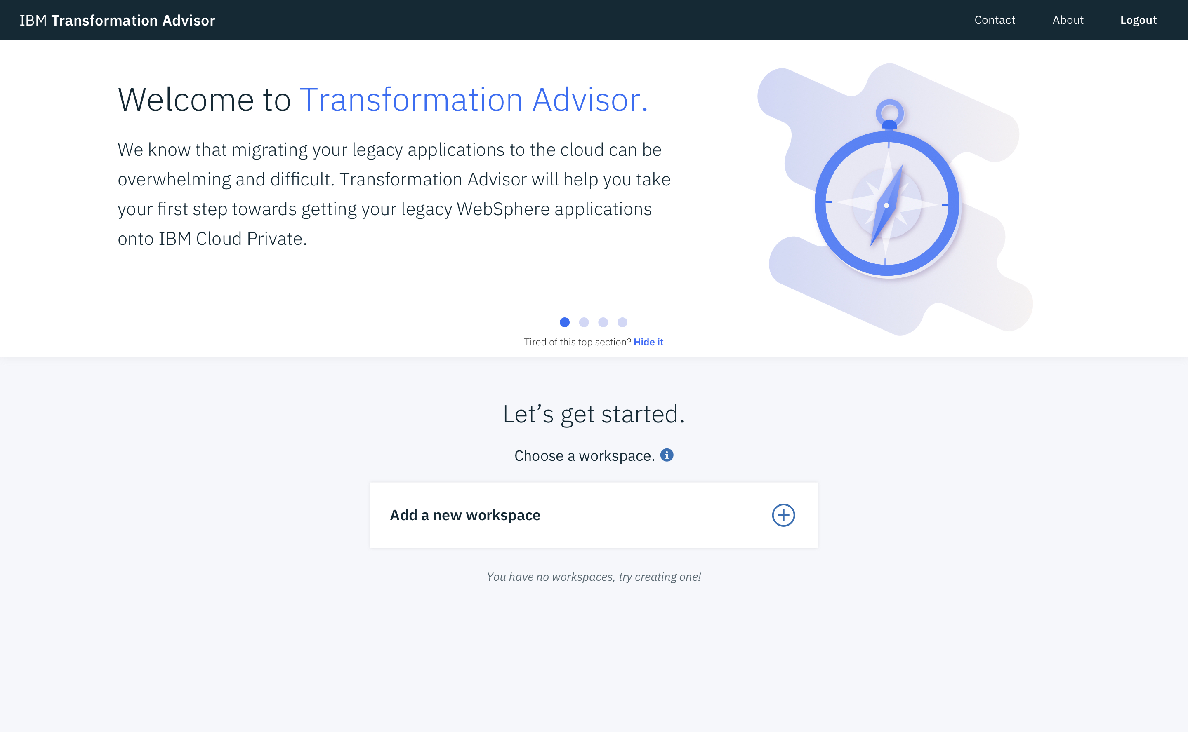
IBM Transformation Advisor
Transformation Advisor is a tool that consumes information about your WebSphere Environment and Applications. These inputs are combined with rules and insights gained from years of working with WebSphere and WebSphere applications to provide recommendations for your cloud journey.
CHALLENGES
Leverage existing application logic
Need to accelerate application development and maintenance
Monolithic applications that are complex and brittle
BENEFITS
Included and deployed on IBM Cloud Private
Introspects existing WebSphere Deployments
THE source of truth
Provides recommendations for Application Modernization
Enabling app modernization for our existing estates is part of our universal platform for IBM middleware in containers

Slide 10
Transforming innovative ideas
… into business value delivered through containers
IBM Microclimate enables rapid creation of new apps which is part of our universal platform for IBM middleware in containers

Slide 11
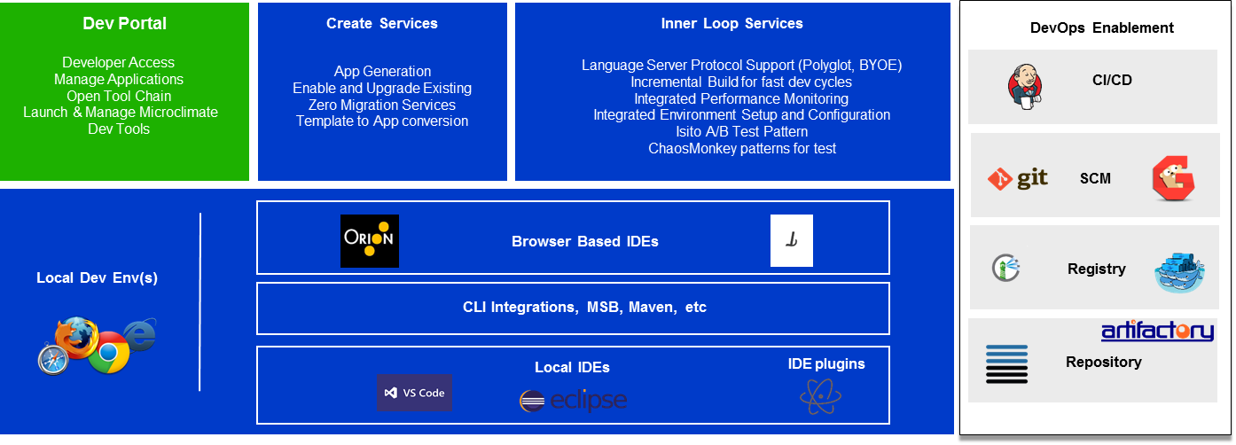
IBM Microclimate
Microclimate is an end to end development environment that lets you rapidly create, edit, and deploy applications. Applications are run in containers from day one and can be delivered into production on Kubernetes through an automated DevOps pipeline using Jenkins. Microclimate can be installed locally or on IBM Cloud Private.
LEGEND:
ICP
Microclimate Local or ICP
Option for 3rd Party
Providing an integrated DevOps experience for all apps is part of our universal platform for IBM middleware in containers

Slide 12
IBM Cloud Private is our universal platform for IBM middleware in containers

Slide 13
IBM Cloud Private: Platform Strategy
Continuously deliver of a set of runtimes, frameworks, and applications consistently across IBM Public and Private Cloud
Priorities
Seamless developer experience
Application modernization
Connect and integrate
Data and analytics
Public
Private
Hybrid
Notes:
2018 Product Strategy:
Deliver a consistent set of runtimes, frameworks, and application servers for Java, Swift, Node, Scala across Public and Private Cloud leveraging Cloud Foundry, Containers, and Virtualization technologies
Deliver a Set of consistent developer tools including Starter Packs, IDEs, and toolchains across the clouds
Deliver a consistent set of APIs for the runtimes across Public and Private Cloud
Spring & IBM collaboration to provide developers easier access within the open-source Spring framework to IBM’s software including WebSphere, DB2, MQ, and more
Deliver IBM Reactive Systems (Lightbend) which is an application development framework and runtime solution for building and deploying elastic, resilient, message-driven applications

Slide 14
Thanks

